Slide 1
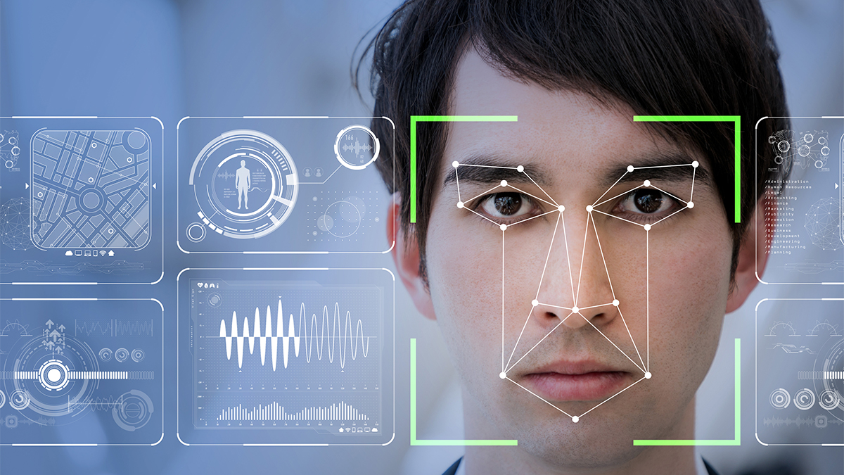
Music Recommendation Using Facial Expression
Ashiq J Maliekal
S3 Mca-A
Roll No : 35

Slide 2
Objective:
The main objective of this project is to recognize a human facial emotion by analyzing the expressions from the camera.
A model is created and consists of emotions such as happy, sad, angry etc. .
These will be detected from the camera and analyzed to give results.
The result is used to recommend music to the user.

Slide 3
Description
It’s a project which is used to read and detect the emotions of people.
First a UI is used to select the language, and then the face is detected. After the detection of face the emotion is predicted.
With the provided result, a list of song is recommended to the user.
The user can play the recommended songs as he/she likes.

Slide 4
Description
The main steps involved in the system
Select the language
Predict the Emotion
Recommend the song

Slide 5
Input/Output and code description
1)User Interface.
Language selection
Emotion prediction
Song recommendation
2)Emotion detection
3)Music Recommendation

Slide 6
ALGORITHM
OpenCV Haar Cascades and how to apply them to real-time video streams.
First published by Paul Viola and Michael Jones in their 2001 paper, Rapid Object Detection using a Boosted Cascade of Simple Features, this original work has become one of the most cited papers in computer vision literature.
They are very efficient feature selection
Various features are extracted at first like egdes,lines etc..

Slide 7

Sample screen shots

Slide 8
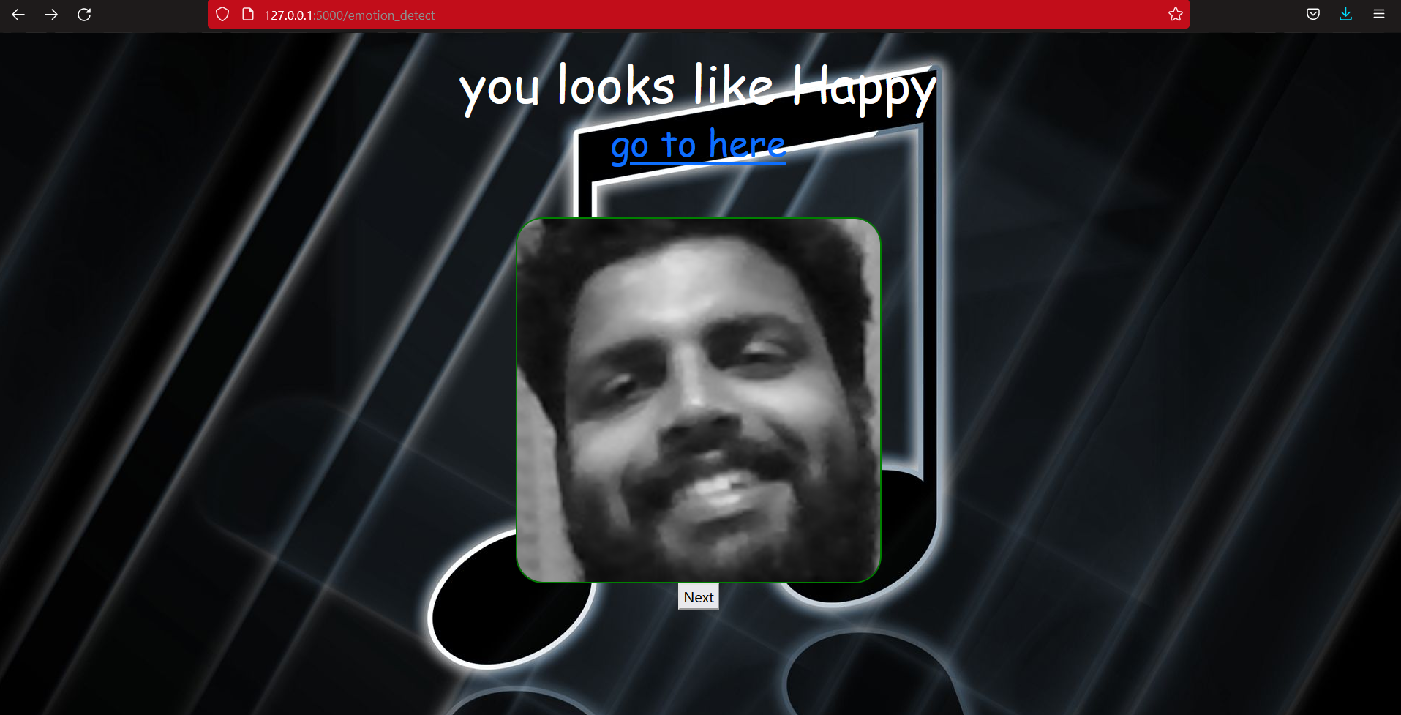


Slide 9
Future scope
People can easily access the song just using facial expressions.
It is fast compared to typing . So in future people may prifer this kind of software rather than slow searching.

Slide 10
THANK YOU

